Slide 1
Beverly Hills Police Department
Neighborhood watch meeting
September 16th, 2019

Slide 2
Agenda
RECRUIMENT & HIRING STATISTICS
CRIME TRENDS/STATISTICS & CRIME PREVENTION
Q&A
NEIGHBORHOOD WATCH & SOCIAL MEDIA
RESIDENTIAL BURGLARY DEPLOYMENTS
PATROL TACTICS
C.C.T.V. CAMERAS
REDUCING CRIME AND KEEPING CALIFORNIA SAFE ACT OF 2020

Slide 3
Recruitment &
HIRING STATISTICS
Sergeant Dimond

Slide 4
Recruitments
In the past year, 13 officers & 10 non-sworn personnel have been hired
Personnel & training has initiated 96 backgrounds and conducted 8 Job Fairs/Recruitments
Coordinated training for 209, totaling 12,390 training hours
OPEN RECRUITMENTS
Sr. Management Analyst (1 Position)
Lateral Communications Dispatcher (3 Positions)
Communications Systems Technician (1 Position)
Police Officer (12+2 Positions)
Police Cadet (Varied)
FTE | 2015/2016 | 2019/2020
COMBINED | 192 | 245
SWORN | 127 | 145
CIVILIAN | 65 | 100

Slide 5
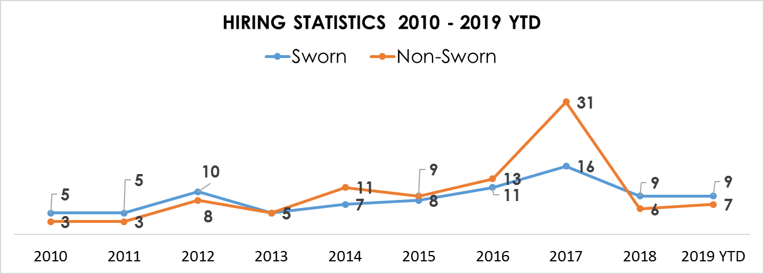
HIRING STATISTICS
Notes:
From 2010 to 2014, there were a total of 32 sworn personnel hired and 30 non-sworn personnel hired.
Within the past five years (2015 to 2019 YTD), there were a total of 53 sworn personnel hired and 66 non-sworn personnel hired.
This represents a 65.63% increase in sworn personnel hired and 120% increase in non-sworn personnel hired.
During 2017, there were a total of 22 parking enforcement officers that transition to traffic control officers.

Slide 6
Residential burglary
deployments
Lieutenant Withers

Slide 7
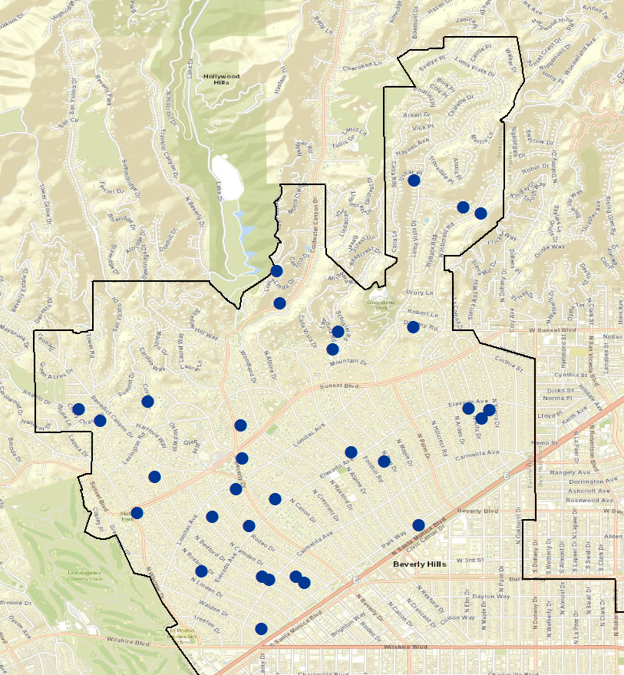
Residential Burglaries
A minimum of 2 patrol units are deployed in the flats each shift
Undercover Unit
K-9 Unit/Officer
City Wide Patrol Officer
the most active days and times of occurrence are Wednesday and Thursday at 9:00 am and 2:00 pm
Notes:
Statistical Information: This year (2019 ) there were a total of 30 residential burglaries in the flats. 14 homes were entered by force and 9 were left unsecured. There were three arrests made in the flats for the month of August.
Case Information: 19-42469, three male suspects were arrested on 08/17/2019 in the 900 Block of N Beverly Dr. Suspects entered through second story window and attempted to steal jewelry and watches.

Slide 8
Residential Burglaries
Burglary Reduction Strategies:
Community awareness
Increased use of undercover/plain clothes patrols to apprehend burglars
Utilizing crime data and analysis in the deployment of patrol
Outside Agency collaboration
CCTV / ALPR Cameras
Strategically parked black & white vehicles

Slide 9
Patrol tactics
Hiring outside security patrol for our streets?
How do suspects "get away”?
The effectiveness of cameras, dogs, gates, and alarms
Release of inmates (AB109, Prop 47 & Prop 57)

Slide 10
PATROL TACTICS
Officer Newman

Slide 11
Patrol tactics
Field Training Officer’s Role
New officers training (both lateral / new hire)
Patrol areas / call location / frequency
Patrol patterns that are taught
Using crime maps to deter
Luck vs Skill vs Priority

Slide 12
CRIME TRENDS/STATISTICS
Crime Impact Team & Detective Bureau

Slide 13
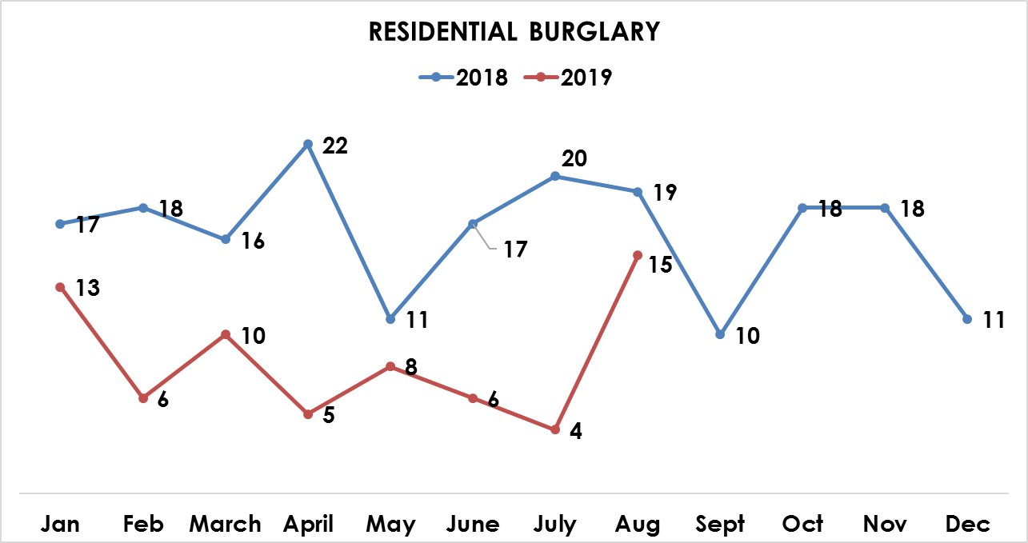
Residential burglary STATISTICS & trends
For 2019, the average number of homes burglarized per month is 12. (2018 = 16, 2017 = 18)
August was the most active month of 2019.
There were a total of 26 Arrests for residential burglary in 2019.

Slide 14
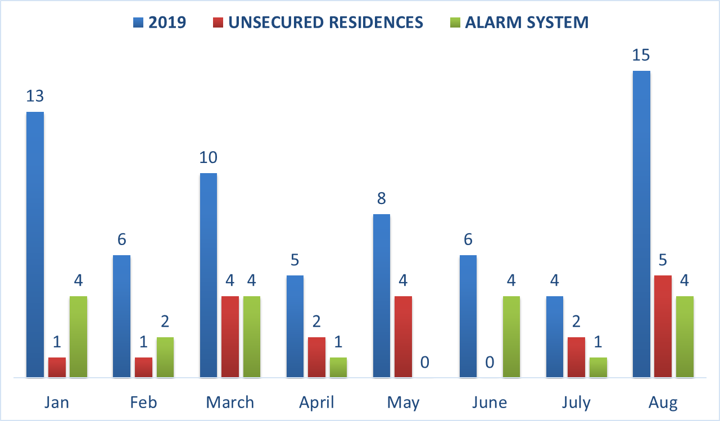
Residential burglary STATISTICS & trends
For 2019, 28% of the residences were left unsecured and only 30% of the burglarized homes did not have their alarm activated.

Slide 15
Crime Prevention / neighborhood watch
&
SOCIAL MEDIA
Sergeant Smollen & C.S.O. Nica

Slide 16
What can you do to protect your home?
If you have a home alarm system, use it. Many individuals have alarm systems but do not arm them because it is inconvenient. Many burglars know this and will not be deterred by a window sticker or sign indicating that the home has an alarm system.
Check alarm system integrity on a regular basis with your alarm company.
Double check alarm notification sequence for timeliness (which affects overall response time).
Ensure sensor coverage includes the 2nd floor if applicable (due to 2nd floor entries).
Check surveillance video system regularly for functionality.
A live feed instance camera that is motion activated (e.g. Ring Security Camera or Nest Cam) is excellent for home security.
If you see suspicious activity, report it ASAP.

Slide 17
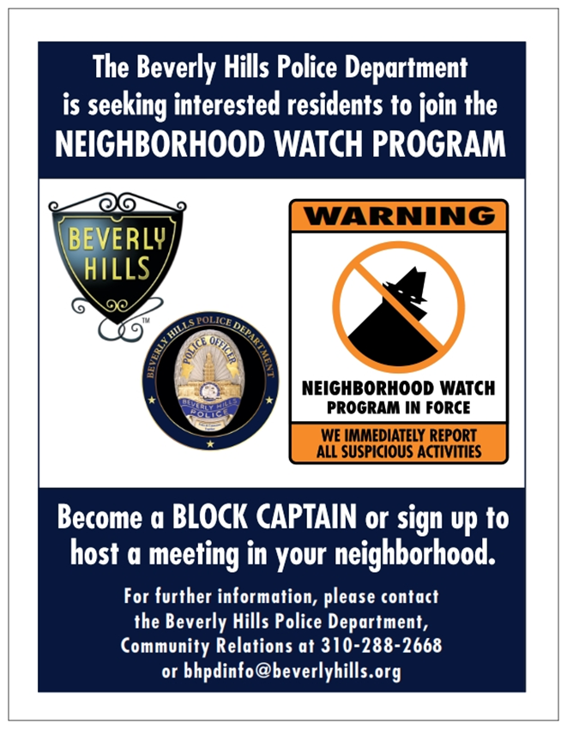
Neighborhood watch
Residence/Business Inspections
Organize neighborhood watch meetings
Contact information:
Email: bhpdinfo@beverlyhills.org
Ph: 310-288-2668

Slide 18
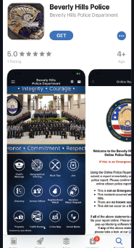
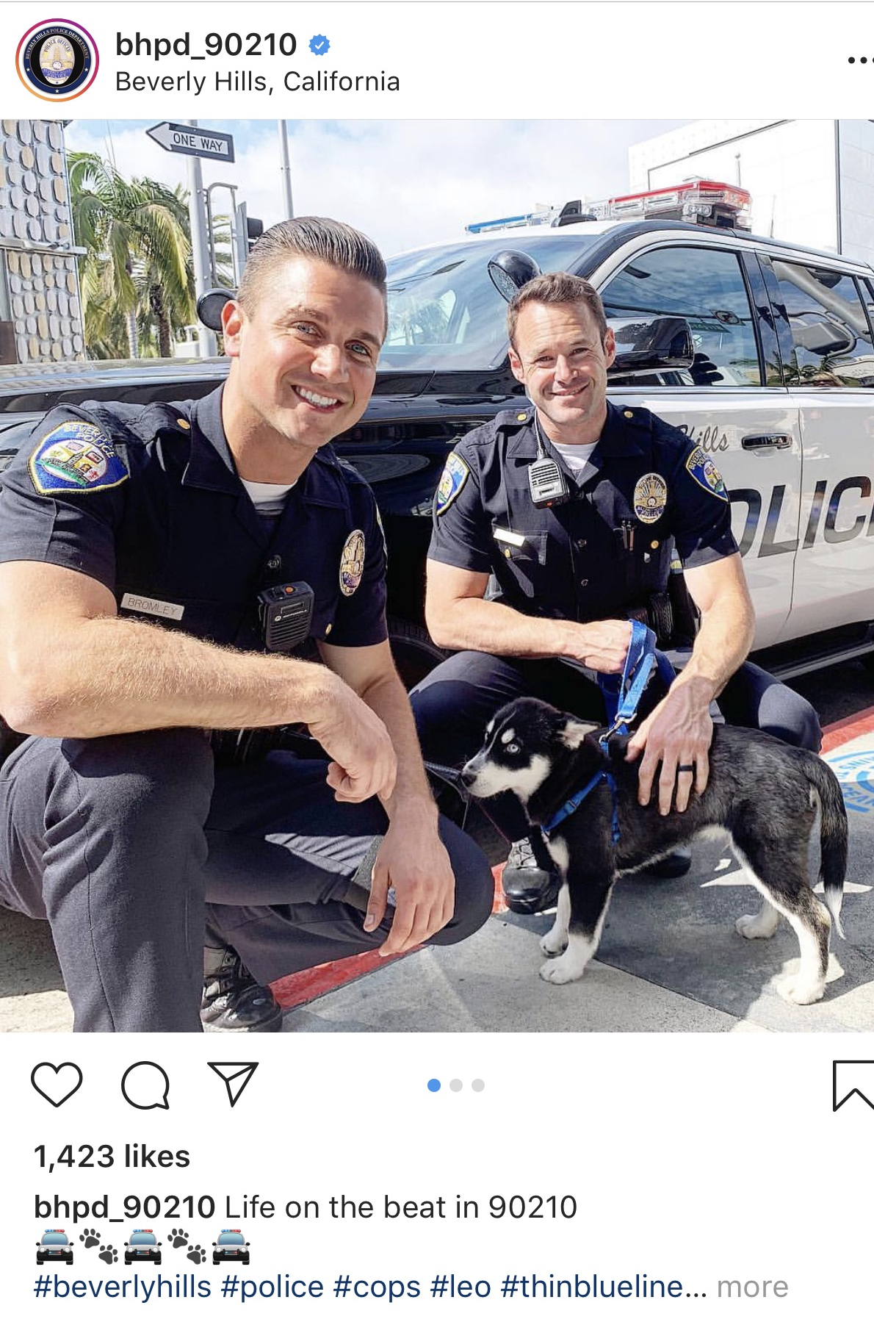
Social media
New Platforms
Behind the Badge
BHPD App
Interactive Crime Map
Crimemapping.com
NIXLE Anonymous Tips
Social Media
Facebook: 8,000+
Twitter: 15,000+
Instagram: 35,000+
YouTube Channel
Notes:
New Platforms:
Behind the Badge
BHPD APP
Interactive Crime Map & crimemapping.com
Nixle Anonymous text tipping
Social Media:
Facebook: 8,500 followers
Twitter: 15,500 followers
Instagram:
Started on May 4, 2015
2017-2019 from 10,000 to 35,000 followers
74% of followers from USA/26% international
YouTube: We have our own channel: BHPD90210 with over 75 videos uploaded
Send us your photos: Police-SocialMediaGroup

Slide 20
C.C.T.V. CAMERAS
Acting Captain Moreno

Slide 21
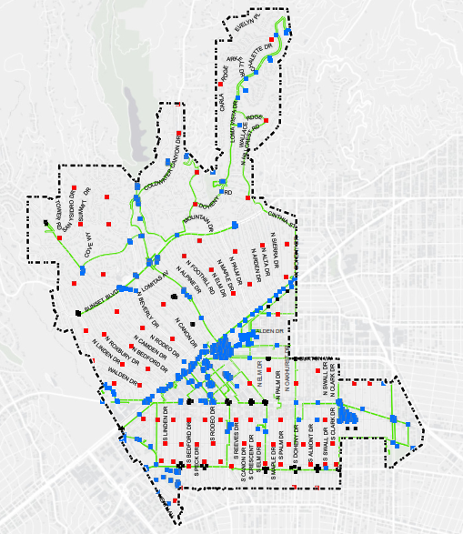
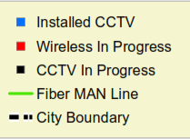
C.C.T.V. CAMERAS
1,000 operational CCTV cameras
1,288 operational cameras expected by end of 2019
Portable CCTV cameras
Solar wireless CCTV cameras
CCTV trailer

Slide 22
Reducing crime and keeping
California safe act of 2020
City Council Adoption Presentation Video

Slide 23
CITY COUNCIL PRESENTATION ON reducing crime and keeping California safe act of 2020
https://vimeo.com/365063686/2305c42512

Slide 24
Reducing crime and keeping California safe act of 2020
Reclassify currently “non-violent” crimes like rape of an unconscious person as “violent” — to prevent the early release of inmates convicted of these crimes
Reform the parole system to stop the early release of violent felons, expand parolee oversight, and strengthen penalties for parole violations
Reform theft laws to restore accountability for serial thieves and organized theft gangs
Expand DNA collection to include those convicted of drug, theft, domestic violence and other serious crimes to help solve rape, murder and other violent crimes — and to exonerate those wrongly accused
Visit https://keepcalsafe.org/ for more information
Notes:
Reclassify currently “non-violent” crimes like rape of an unconscious person, sex trafficking of a child and 14 other serious crimes as “violent” — to prevent the early release of inmates convicted of these crimes
Reform the parole system to stop the early release of violent felons, expand parolee oversight, and strengthen penalties for parole violations
Reform theft laws to restore accountability for serial thieves and organized theft gangs
Expand DNA collection to include those convicted of drug, theft, domestic violence and other serious crimes to help solve rape, murder and other violent crimes — and to exonerate those wrongly accused

Slide 25
QUESTIONS?

